Slide 1



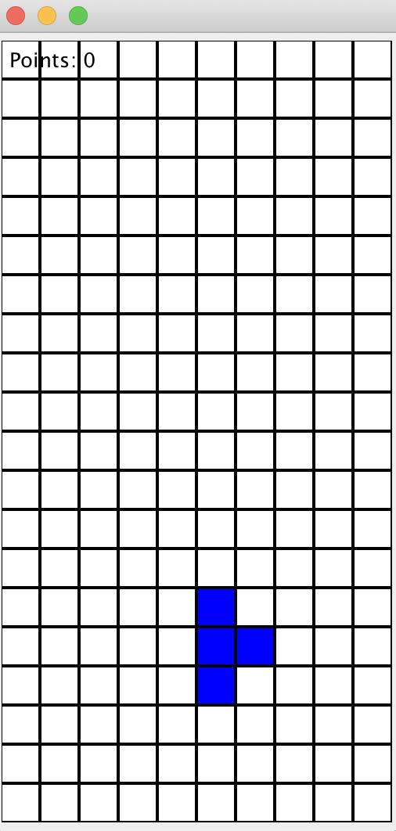
Tetris Game
Group 6 Khanh Phan, Shaista Usman, Yi Niu

Slide 2
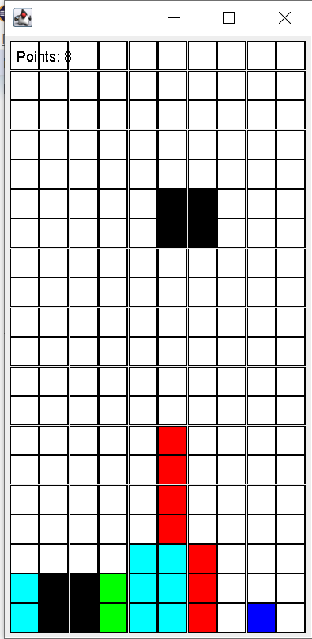
Tetris Game

Slide 3
Junit Tests

Slide 5

Code Coverage Analysis

Slide 6
Code coverage

Slide 7
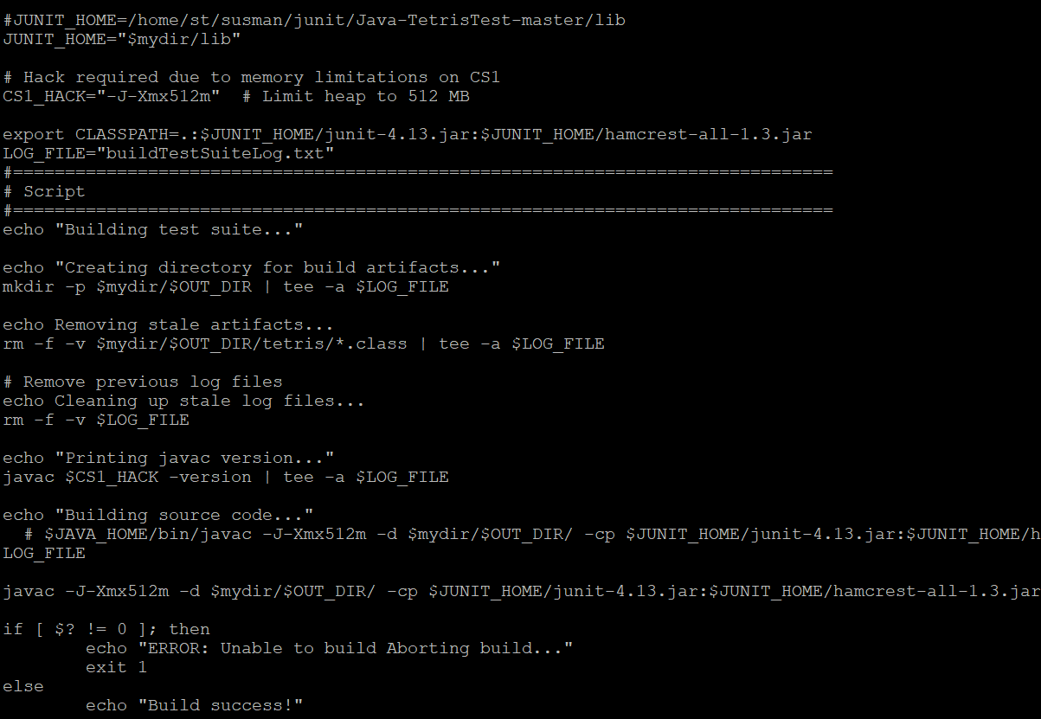
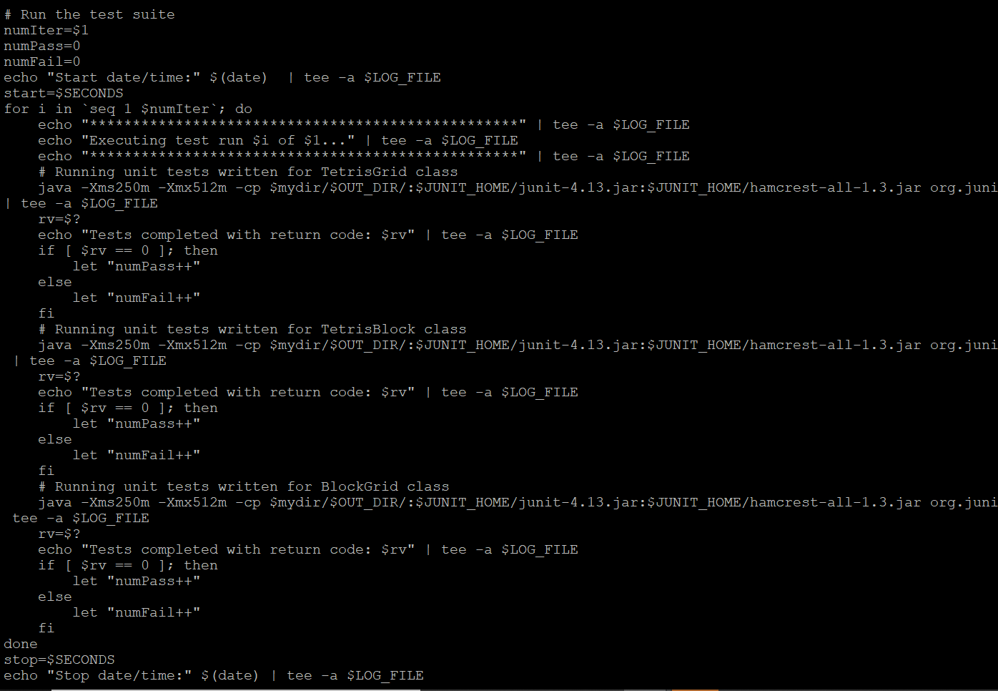
Building the Test Suite and Automating the Test Run

Slide 8
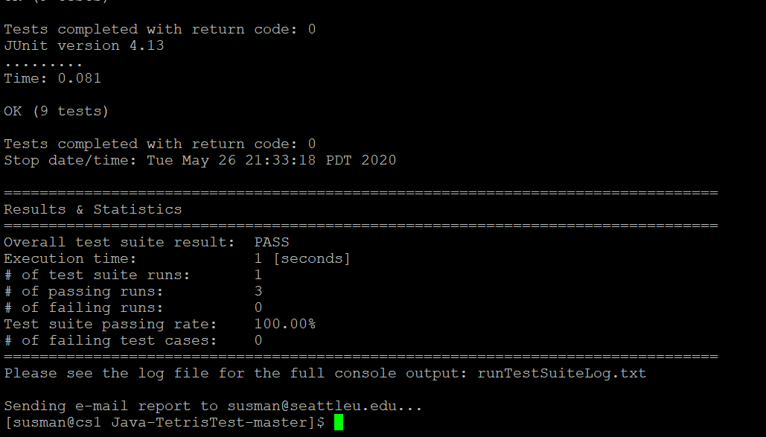
Executing the Test Suite

Slide 9
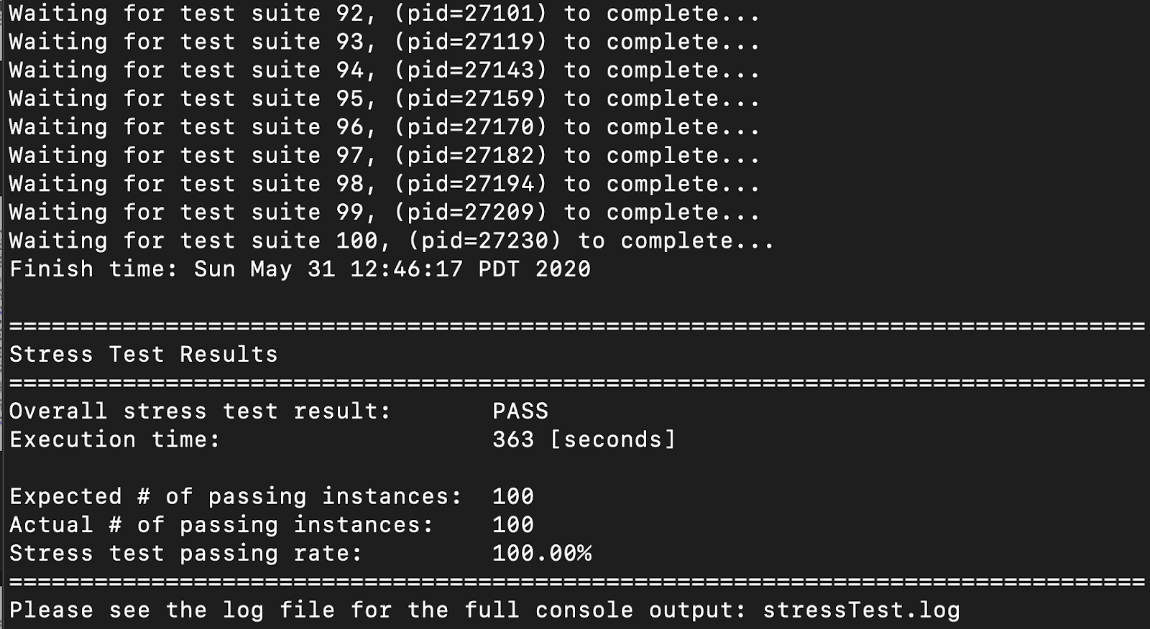
Stress Testing

Slide 10
Stress Testing

Slide 11
Thank You!

